Slide 1
The Principles of Design
& Typography
07
I399 Web Development

Slide 2
The Principles of Design

Slide 3
Design a business card
Take out a piece of paper to draw on.. This will be your participation today. Several parts so hang on to it! :-)
Draw a rectangle on your paper, roughly 3.5 x 2 inches.
Design a business card with the following information:
Ellen Starr Lyon
Fine Art Oil Painting
1122 S Azalea Dr, Bloomington, IN
ellen_lyon@gmail.com
812-855-1212

Slide 4
Four Basic Design Principles
CONTRAST
REPETITION
ALIGNMENT
PROXIMITY
These interconnected principles appear in every well-designed work.
Other design principle lists exist, but you can’t go wrong with this CRAP.
Better design = better communication

Slide 5
PROXIMITY
Fine Art Oil Painting
ellen_lyon@gmail.com
QUESTIONS:
How many times do your eyes stop as you view the content on this business card?
Where do we start reading?
Where should we end?
Does your eye wander around making sure you got all the corners?
Ellen Starr Lyon
1122 S Azalea Drive
Bloomington, Indiana
(812) 555 - 1212

Slide 6
PROXIMITY
When visual elements are put close together, they become one visual unit instead of several. (visually more organized)
Proximity (closeness) of the content, implies a relationship. (intellectually more organized)
Does this look more organized?
Do you now know where to begin to read and know when you have finished?
Do you see that the white space is also more organized?
Ellen Starr Lyon
Fine Art Oil Painting
1122 East Azalea Drive
Bloomington, Indiana
ellen_lyon@gmail.com
(812) 555 - 1212

Slide 7
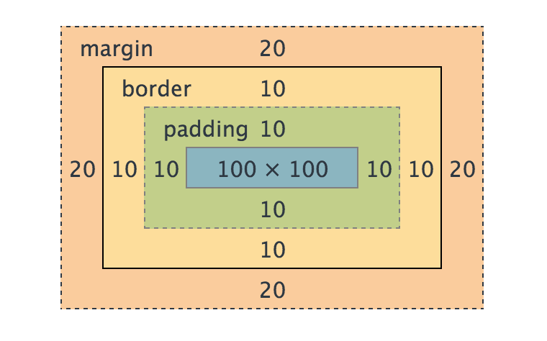
PROXIMITY
One of the first steps in creating a web page is to markup content with HTML.
But HTML tags, by default, will EVENLY SPACE everything and separate elements whether they are related or not.
First step is to put content that is related together in your code.
Then, it is up to you to become a master with padding and margin, and adjust the spacing to create closeness between related pieces of content.

Slide 8
ALIGNMENT
This is a perfectly fine business card.
But because of the center alignment, the edges are soft and we don’t immediately see the strength of the line.
Ellen Starr Lyon
Fine Art Oil Painting
1122 East Azalea Drive
Bloomington, Indiana
ellen_lyon@gmail.com
(812) 555 - 1212

Slide 9
ALIGNMENT
Same logical arrangement, but left-aligned. Because there isn’t much content, you could have also pulled off a right-align for this card.
Can you see the “line” created by the edge?
The strength of this edge is what gives strength to the layout.
Ellen Starr Lyon
Fine Art Oil Painting
1122 East Azalea Drive
Bloomington, Indiana
(812) 555 - 1212
ellen_lyon@gmail.com

Slide 10
ALIGNMENT
Nothing should be placed arbitrarily. Lining elements up allows us to unify and organize our designs.
When dealing with text we call this alignment.
In designing an entire page, we often talk about creating an underlying grid.
> Be careful not to use more than one alignment in a design element, and more than a few on a page.
> Center alignment is for formality. Think queen’s party or graduation invitation.

Slide 11
CONTRAST
Dec 14, 2016
Straight No Chaser
Home for the holidays with their "I'll Have Another...World Tour"
IU Auditorium 8pm
Straight No Chaser is a master of reinventing a cappella on the modern pop landscape. Originally formed in 1996 at Indiana University, the group has reassembled and reemerged as a phenomenon, now embarking on their 20th anniversary “I’ll Have Another…World Tour."
We’ve applied proximity and alignment to this event listing about a concert, but it’s still not very interesting.
We have not weighted the content, so the reader isn’t immediately filled in on what is important, and what is subsidiary.
Add contrast by varying the size, placement, color, weight, and so on.

Slide 12
CONTRAST
Just by varying the size, color, and weight of the typography, we can improve the design.
Sometimes design principles include balance, and hierarchy.
These both are aspect of adding contrast and thus interest and emphasis to your designs.
Dec 14, 2016
Straight No Chaser
Home for the holidays with their "I'll Have Another...World Tour"
IU Auditorium 8pm
Straight No Chaser is a master of reinventing a cappella on the modern pop landscape. Originally formed in 1996 at Indiana University, the group has reassembled and reemerged as a phenomenon, now embarking on their 20th anniversary “I’ll Have Another…World Tour."

Slide 13

REPETITION
What design elements are repeated in this design?

Slide 14

REPETITION
How about in this design? What elements repeat?
Poster for AIGA (American Institute of Graphic Arts) Get Out the Vote campaign, part of the Design for Democracy Initiative. Created by Jenny El-Shamy Design.

Slide 15
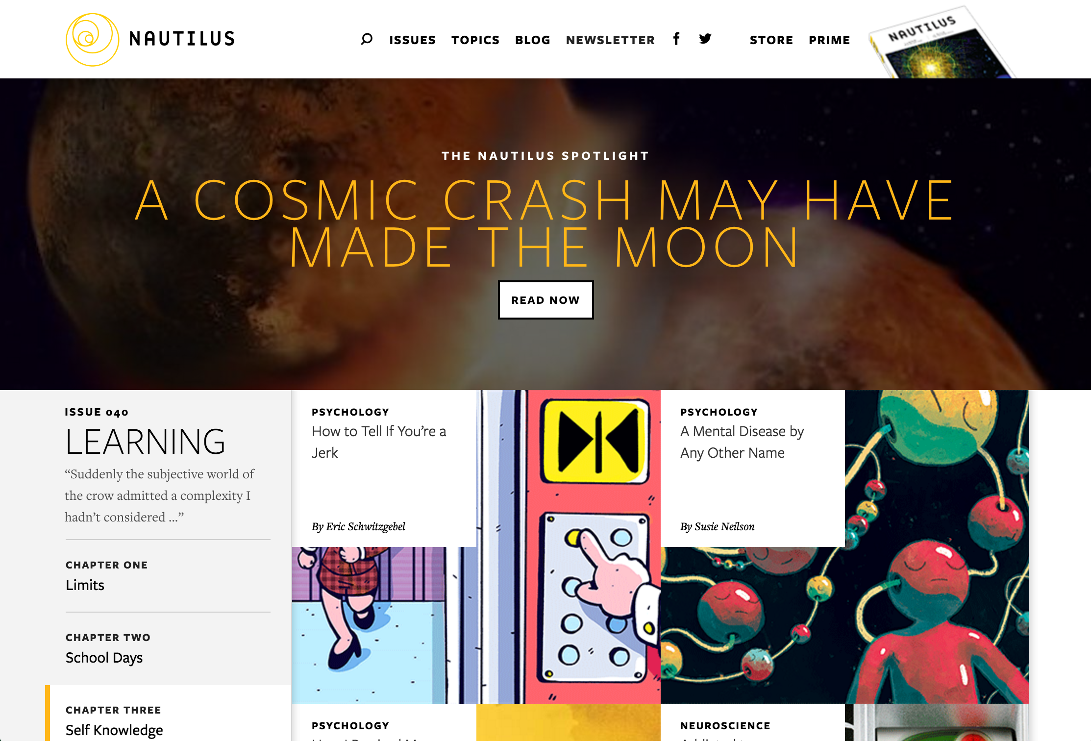
REPETITION
Repetition helps create unity.
By repeating some aspect or element of our design, we add visual interest and we show that our design works as a whole.
We want to take some of the existing consistencies and push them further.
> Avoid repeating an element so much that is becomes annoying.
> Repetition can be of a type treatment, a design element, a color.. Any aspect can be repeated.
Let’s evaluate the design of this site together.

Slide 16
Re-design a business card
Using the CRAP principles of design, draw another business card.
Draw a second rectangle on your paper, same size.
Design a business card with the following information:
Ellen Starr Lyon
Fine Art Oil Painting
1122 S Azalea Dr, Bloomington, IN
ellen_lyon@gmail.com
812-855-1212
Assume you can use an image of a painting this time around. When sketching, we usually indicate an image with a shaded box with an X inside.

Slide 17
Typography

Slide 18
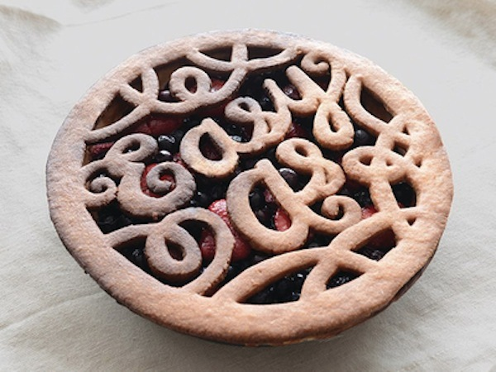
Typography is about seeing type as a visual form

Slide 19
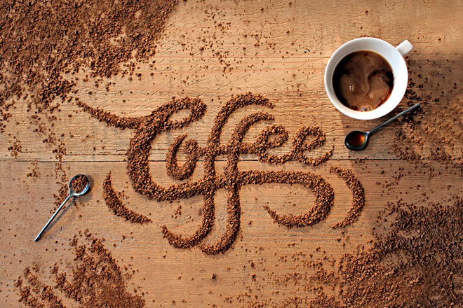
Typography is about seeing type as a visual form

Slide 20
What to watch for:
M
1. Serif or sans serif
2. Proportion
3. Contrast
4. Arm type
5. Openings
6. Midlines
7. x-height
8. Details
M

Slide 21
Website
x-height
OOO O & & &

Slide 22
These small details define a typeface’s character:
A large x-height makes a typeface appear larger than another in the same size.
If each letter has the same amount of space = “mono-spaced”
Arm positioning/shape, opening differences, and stroke width can all vary widely.
SHOUT whisper

Slide 23
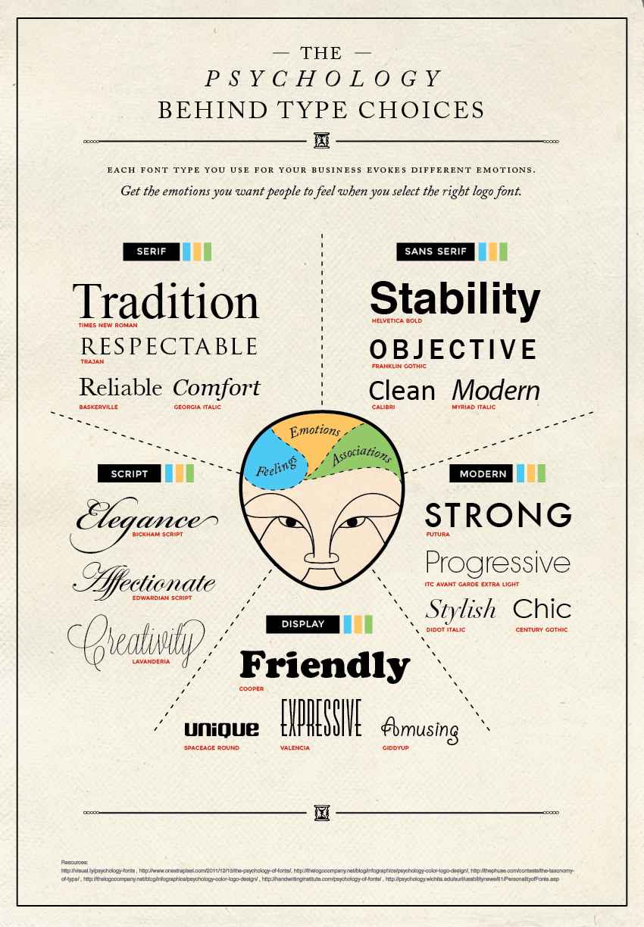
...and character implies emotion.
Your typography choices should support, not detract from or contrast with, the rest of your website design.

Slide 24
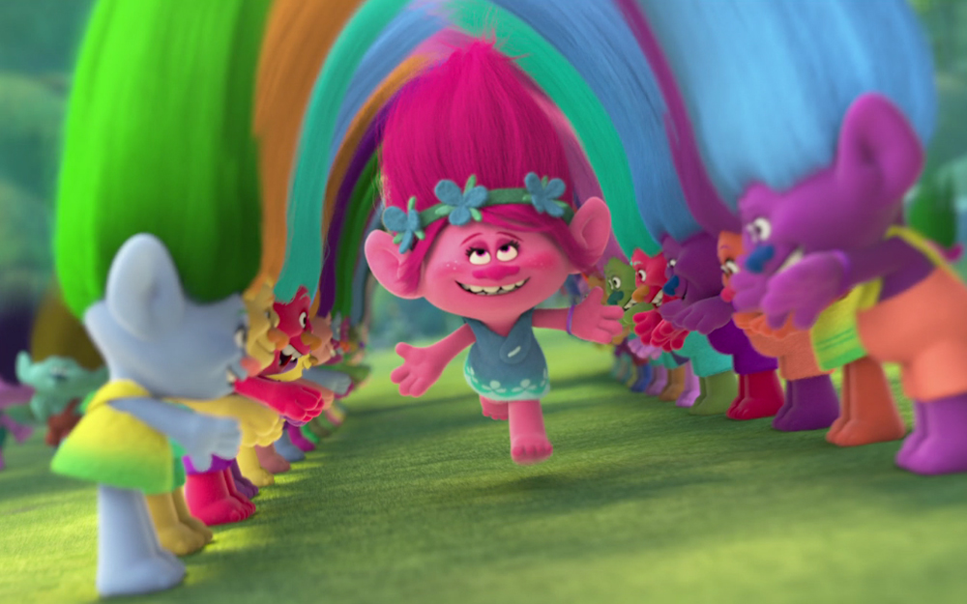


Slide 25


Slide 26


Slide 27


Slide 28
Advice on paragraphs

Slide 29
Keep Paragraphs a reasonable width
Paragraphs are created by multiple lines of text. These lines have to be close enough together that they read as one block, but far enough apart that one can pick out the lines easily. If the lines are too far apart or too long, the reader has a hard time finding the next line.
too wide
Paragraphs are created by multiple lines of text. These lines have to be close enough together that they read as one block, but far enough apart that one can pick out the lines easily. If the lines are too far apart or too long, the reader has a hard time finding the next line.
Paragraphs are created by multiple lines of text. These lines have to be close enough together that they read as one block, but far enough apart that one can pick out the lines easily. If the lines are too far apart or too long, the reader has a hard time finding the next line.
too narrow
just right

Slide 30
Keep paragraphs a reasonable line-height
Paragraphs are created by multiple lines of text. These lines have to be close enough together that they read as one block, but far enough apart that one can pick out the lines easily. If the lines are too far apart or too long, the reader has a hard time finding the next line.
Paragraphs are created by multiple lines of text. These lines have to be close enough together that they read as one block, but far enough apart that one can pick out the lines easily. If the lines are too far apart or too long, the reader has a hard time finding the next line.
a little too narrow
Paragraphs are created by multiple lines of text. These lines have to be close enough together that they read as one block, but far enough apart that one can pick out the lines easily. If the lines are too far apart or too long, the reader has a hard time finding the next line.
too wide
just right

Slide 31
Be careful of paragraph alignment other than left...
Paragraphs are created by multiple lines of text. These lines have to be close enough together that they read as one block, but far enough apart that one can pick out the lines easily. If the lines are too far apart or too long, the reader has a hard time finding the next line.
Paragraphs are created by multiple lines of text. These lines have to be close enough together that they read as one block, but far enough apart that one can pick out the lines easily. If the lines are too far apart or too long, the reader has a hard time finding the next line.
Paragraphs are created by multiple lines of text. These lines have to be close enough together that they read as one block, but far enough apart that one can pick out the lines easily. If the lines are too far apart or too long, the reader has a hard time finding the next line.
centered
right
justified

Slide 32
Headlines and content make up a BLOCK
Headline Positioned with Equal Space on Top and Bottom Doesn’t Look Related to the Content
Headline Positioned with Unequal Space on Top and Bottom DOES Look Related to the Content
Paragraphs are created by multiple lines of text. These lines have to be close enough together that they read as one block, but far enough apart that one can pick out the lines easily. If the lines are too far apart or too long, the reader has a hard time finding the next line.
Paragraphs are created by multiple lines of text. These lines have to be close enough together that they read as one block, but far enough apart that one can pick out the lines easily. If the lines are too far apart or too long, the reader has a hard time finding the next line.

Slide 33
Headlines and content make up a BLOCK
Headline Positioned with Equal Space on Top and Bottom Doesn’t Look Related to the Content
Headline Positioned with Unequal Space on Top and Bottom DOES Look Related to the Content
Paragraphs are created by multiple lines of text. These lines have to be close enough together that they read as one block, but far enough apart that one can pick out the lines easily. If the lines are too far apart or too long, the reader has a hard time finding the next line.
Paragraphs are created by multiple lines of text. These lines have to be close enough together that they read as one block, but far enough apart that one can pick out the lines easily. If the lines are too far apart or too long, the reader has a hard time finding the next line.
Adjust line-height, margins (perhaps removing), and padding to allow related content to sit closer together.

Slide 34
Typography Pairing Exercise Tips
→ Download Type-Pairs.docx.
Select very different type faces, if one is serif, the other should not be.
Use Format > Font to adjust each selection.
Vary SIZE, COLOR, TONE, TYPEFACE, WEIGHT, etc.. to add interest to our type pairs.
… the first one has been done for you as an example. IF YOU FEEL COMFORTABLE WITH ADOBE, FEEL FREE TO USE ILLUSTRATOR.

Slide 35
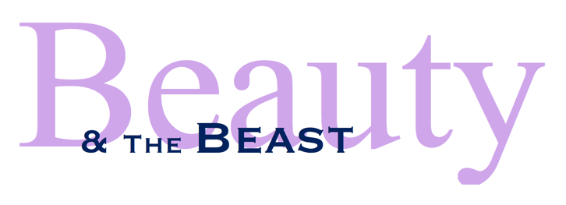
Courtney Norenberg, 2016

